Slide 1
FUDEGMARTFLIX:
INTEGRATED DATA WAREHOUSE & BUSINESS INTELLIGENCE
By
Bhavish Kumar
Pranav Kottoli Radhakrishna
Prankur Garg
Saheb Singh
Shahzeb Anwar

Slide 2
Agenda
Introduction to fudgemart and fudgeflix companies
Overview of business functions
Overview of Data warehousing strategy
Overview of Business Intelligence

Slide 3
Introduction to Fudgemart and Fudgeflix
Fudgemart inc. is a conglomerate that currently maintains two databases for their subsidiaries Fugdemart and Fudgeflix
Fudgemart is a fictitious online retailer, similar to Amazon.com or Walmart.com offering a plethora of products for their customers
Fudgeflix is a fictitious online DVD by mail and video on demand service, similar to Amazon instant video or Netflix

Slide 4
Business Requirement
Currently, two separate databases are maintained for the two subsidiaries Fudgemart & Fudgeflix
The business requires data to be consolidated and integrated in a Data Warehouse to better identify growth opportunities.
The business process we will be focusing on is Order Fulfillment which aims to find how long it takes to ship a product once it has been defined
Business Goals:
Provide a consolidated view of order fulfillment across the two subsidiaries
Identify departments and products for which order fulfillment can be improved
Identify the geographic locations from which the organization can improve upon the order fulfillment process regionally

Slide 5
Functional Requirements
Do orders that are to be fulfilled in certain customer locations take longer to ship?
Which customer locations receive the maximum number of orders?
Which Product Departments receive the maximum number of orders?
Do certain Products & Product Departments take longer to ship?
Do orders with higher order quantity take longer to ship?

Slide 6
Implementation Strategy
Design High Level Dimensional Modelling Worksheet
Design Detailed Dimensional Modelling Worksheet
Generate ROLAP script and create DW tables
Design SSIS packages to perform ETL operations
Stage & Load Date
Stage Fudgemart data & Load it
Stage Fudgeflix data & Load it
Build the MOLAP Cube
Connect Power BI dashboard to warehouse & generate Business Intelligence

Slide 7
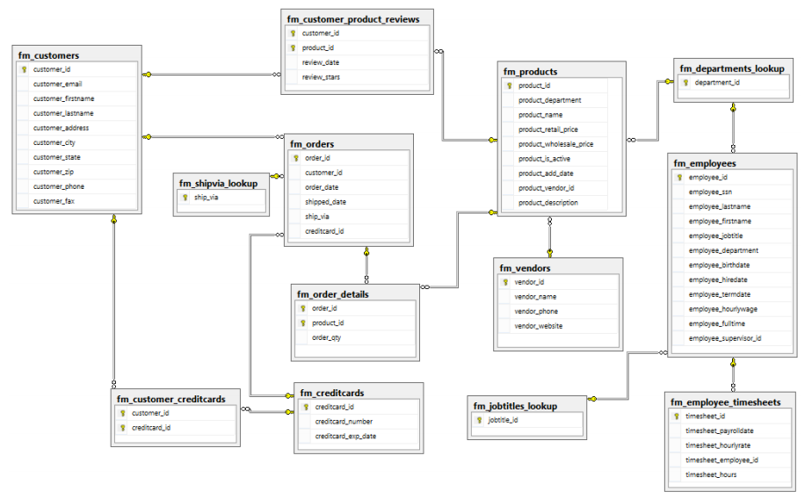
Fudgemart Schema

Slide 8
Analysis of Fudgemart
The order fulfillment process in Fudemart is captured by the following tables:
fm_orders - Contains details about each order
fm_order_details - Acts as an associative table to link orders and products
fm_customers - Contains details about customers
fm_products - Contains details about products

Slide 9
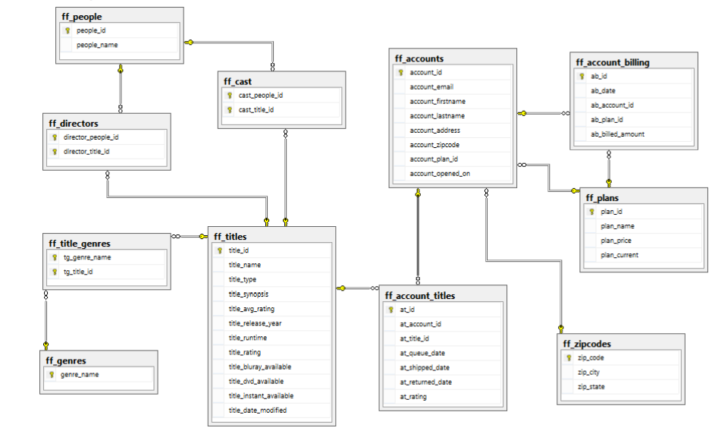
Fudgeflix Schema

Slide 10
Analysis of Fudgeflix
The order fulfillment process in Fudgeflix is captured by the following tables:
ff_titles - Contains details about the products offered by Fudgeflix
ff_account_titles - Contains details about each order & its fulfillment
ff_accounts - Contains details about each customer

Slide 11
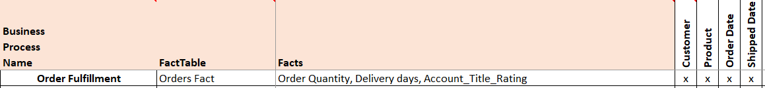
High level & Detailed Dimensional Modeling
Identify dimensions, facts & their attributes in a high-level dimensional model workbook for Order Fulfillment business process
Identify the data type, size & source of all the attributes in the Detailed Dimensional Modeling Worksheet
Identify Primary Key & Foreign Key attributes in the Fact table

Slide 12
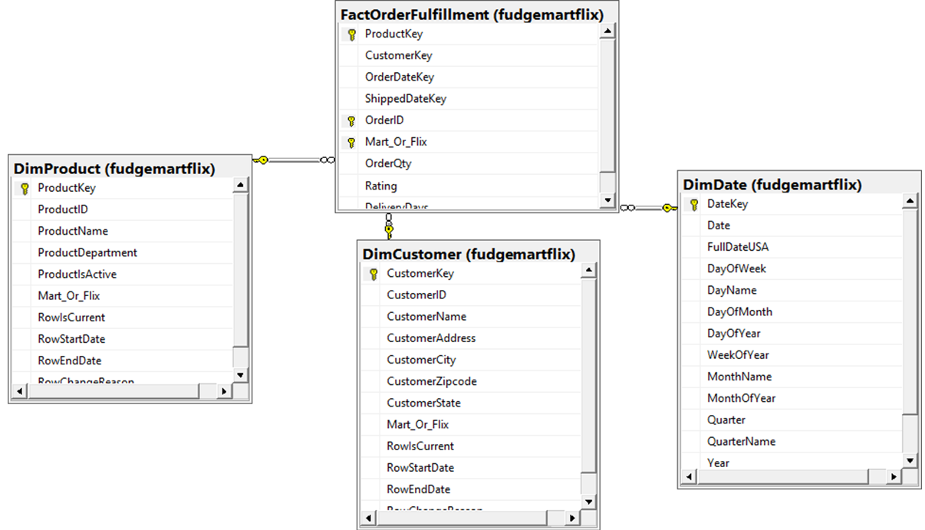
Build Star Schema
Execute script obtained from Detailed Dimensional Modeling worksheet to create DW Fact & Dimension tables (ROLAP Star Schema)

Slide 13
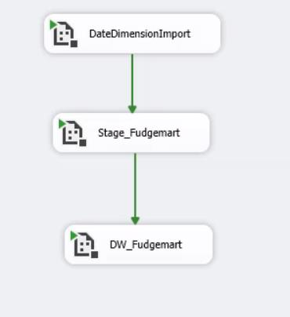
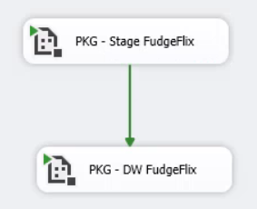
Staging and Loading (ETL) with SSIS
ETL for Fudgemart
ETL for Fudgeflix

Slide 14
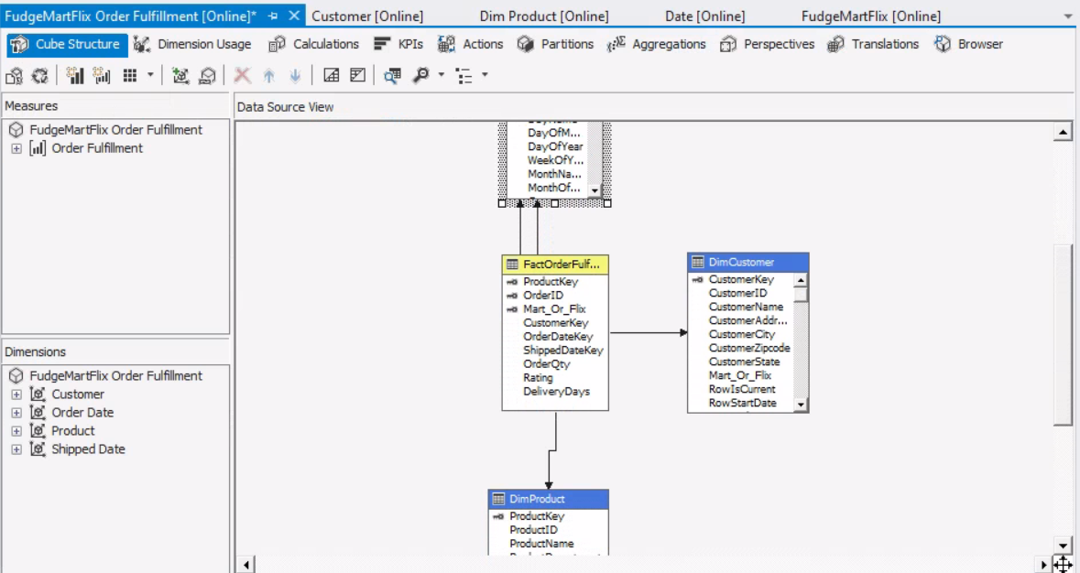
Create MOLAP Cube
Build a MOLAP cube with precomputed measures for faster query performance

Slide 15


Slide 16
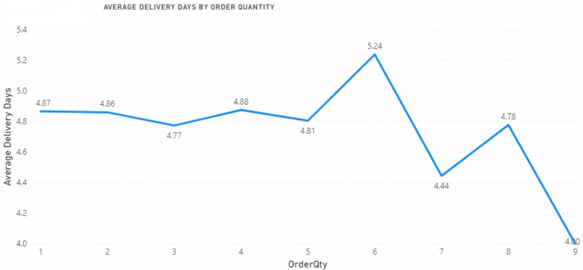
Average Delivery Days VS Order Quantity - Fudgemart Orders
Notes:
Large Fudgemart orders with higher order quantity have a lower average of delivery days

Slide 17
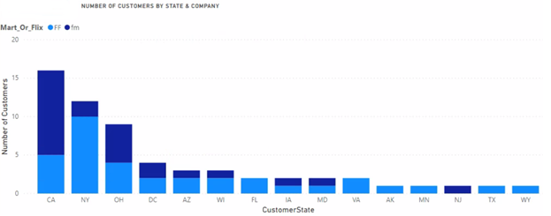
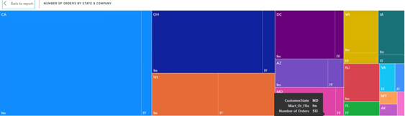
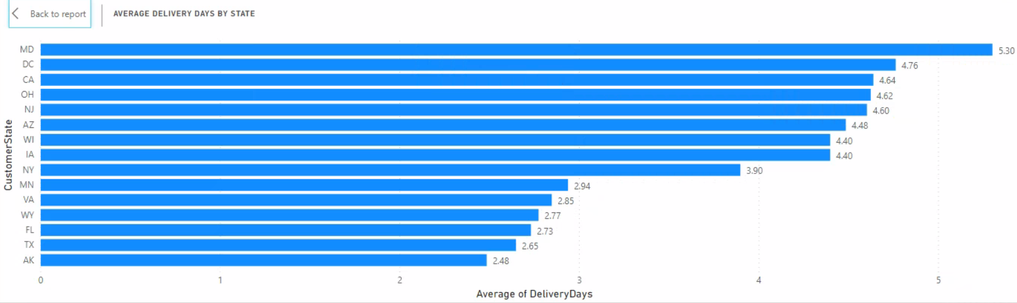
Trends in Order Fulfillment across Customer States
Notes:
California, New York & Ohio are the states having the highest number of Customers. Although NY state has a very low proportion of FM customers, the number of order coming from FM > number of FF orders. i.e. Despite NY state has a very large FF customer base, the number of FF orders coming in from NY state < number of FM orders.
The highest number of the orders for the company are coming from the state of California (CA) as expected because of the large customer base in California. This is followed by the states of Ohio & New York
The Orders fulfilled in the state of Maryland (MD) have the highest average delivery days which is calculated as sum of delivery days divided by number of orders. Maryland is followed by the state of DC & California. These states need to improve their average delivery days.

Slide 18
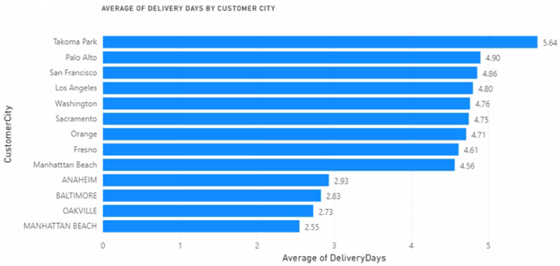
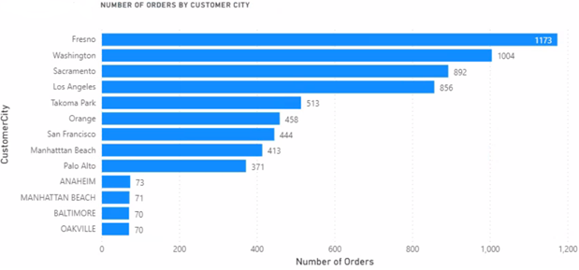
Deep Dive into states with highest average Delivery Days
Notes:
This slide covers cities from the top 3 states with highest average delivery days
The city of Takoma Park in Maryland has the highest average Delivery Days, which is followed by the city of Palo Alto & San Francisco
The city of Fresno has the highest number of orders, followed by Washington & Sacramento. It is important to focus on these cities as they have a large number of orders and unfortunately they have a high average delivery days too

Slide 19
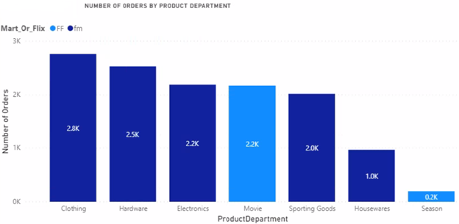
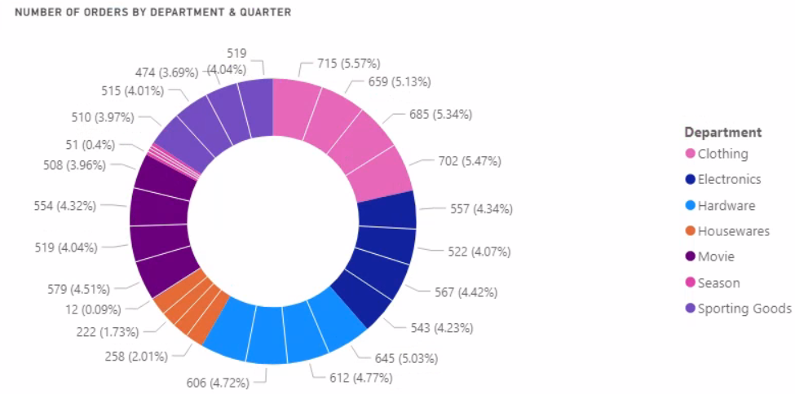
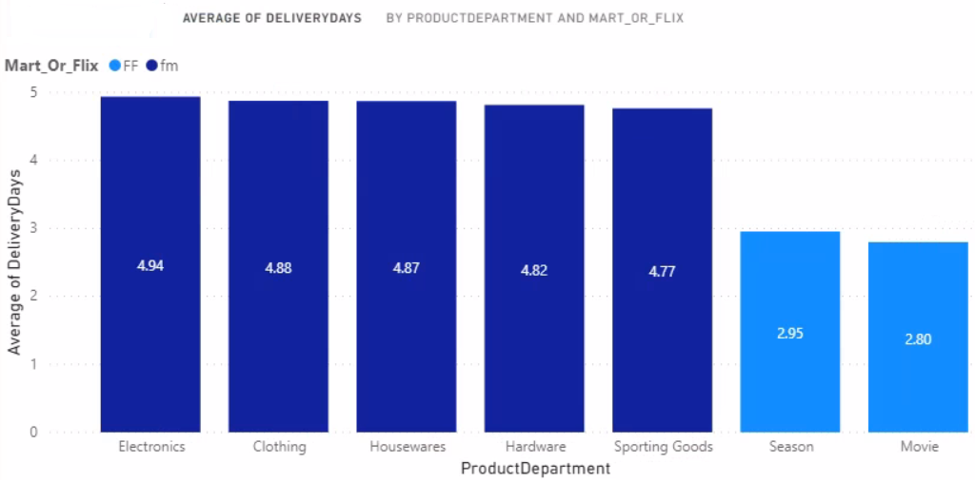
Trends in Order Fulfillment across Product Departments
Notes:
The Clothing department has the highest number of orders, followed by the Hardware Department
The average delivery days is pretty much uniform within all the departments of Fudgemart & also within all the Fudgeflix departments too. But the orders containing products from the Fudgemart departments have a higher average delivery days which can be improved, as we can see that the orders from FudgeFlix departments have a much lower average delivery days
The pie chart shows that every departments has an equal number of orders across the 4 quarters
The pie chart shows us that the number of orders is pretty much uniform across every quarter for a given department

Slide 20
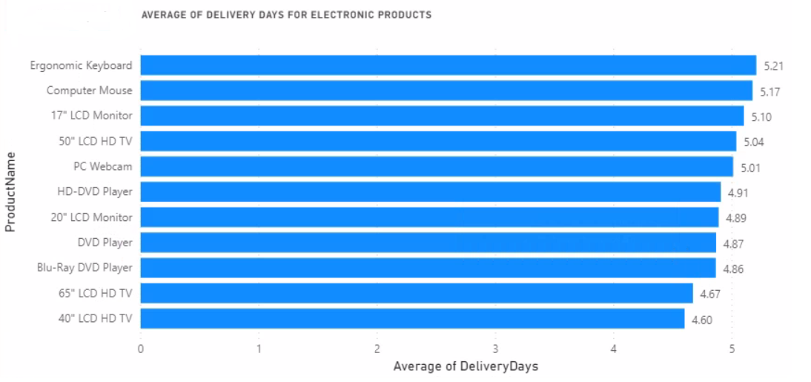
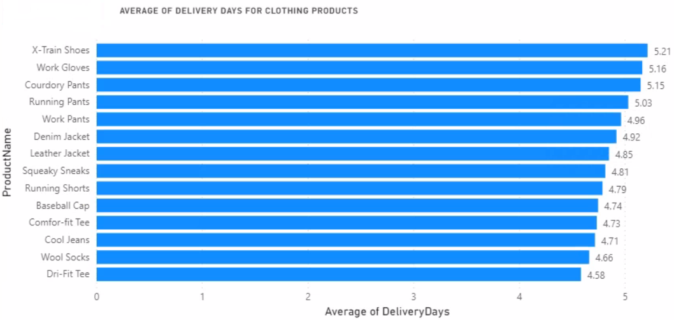
Deep Dive into Electronics & Clothing Departments
Notes:
Since Electronics & Clothing department orders have the highest average delivery days, we will deep dive into these departments and look into the average delivery days of the products from these departments
In the Electronics department, we can observe that the products Ergonomic Keyboard and Mouse have relatively higher average delivery days which needs to be improved.

Slide 21
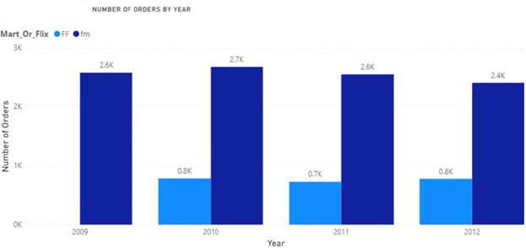
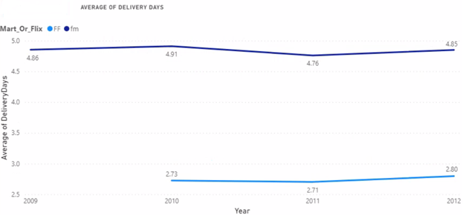
Order Fulfillment over Time
Notes:
We can observe a gradual decrease in the number of Fudgemart orders over the years from the year 2010 till 2012
The average delivery days is only having very minute fluctuations over the years. However, the average delivery days for Fudgemart orders are higher than Fudgeflix orders

Slide 22
RECOMMENDATIONS
Improve Order Fulfillment process in the states of MD, DC & CA to reduce delivery time
Fudgemart orders have a higher average delivery days which needs to be improved
Focus on improving the delivery time for the products “Ergonomic Keyboard” and “Computer Mouse” from the Electronics Department
Similarly, work towards improving delivery time for the products “X-Train Shoes” & “Work Gloves” from the Clothing Department
Work towards improving delivery time of smaller orders

Slide 23
THANK YOU

